Slide 1




COVID-19 DATA ANALYSIS OF INDIA

Slide 2

INTRODUCTION
COVID-19 is the disease caused by SARS-CoV-2, the coronavirus that emerged in December 2019.
Variants:-delta,delta7,delta21_14,meta,total
COVID-19 can be severe, and has caused millions of deaths around the world as well as lasting health problems in some who have survived the illness.

Slide 3
Methodology
DATA SCRAPPING
(REQUEST,FILE HANDLING)
DATAFRAME CLEANING
(PANDAS)
DATAFRAME CONVERSION
(EXCEL)
DATAFRAME ANALYZING
(MS-SQL)
DATAFRAME VISUALIZATION
(Tableau)

Slide 4
OBJECTIVES
To Extract Covid 19 India data (NESTED JSON) from covid19india.org
To Convert the data into required Data Frames and to Excel files
To analyze data using MS-SQL(SSMS)
To Work on data for Insights and visualizing using Tableau.

Slide 5
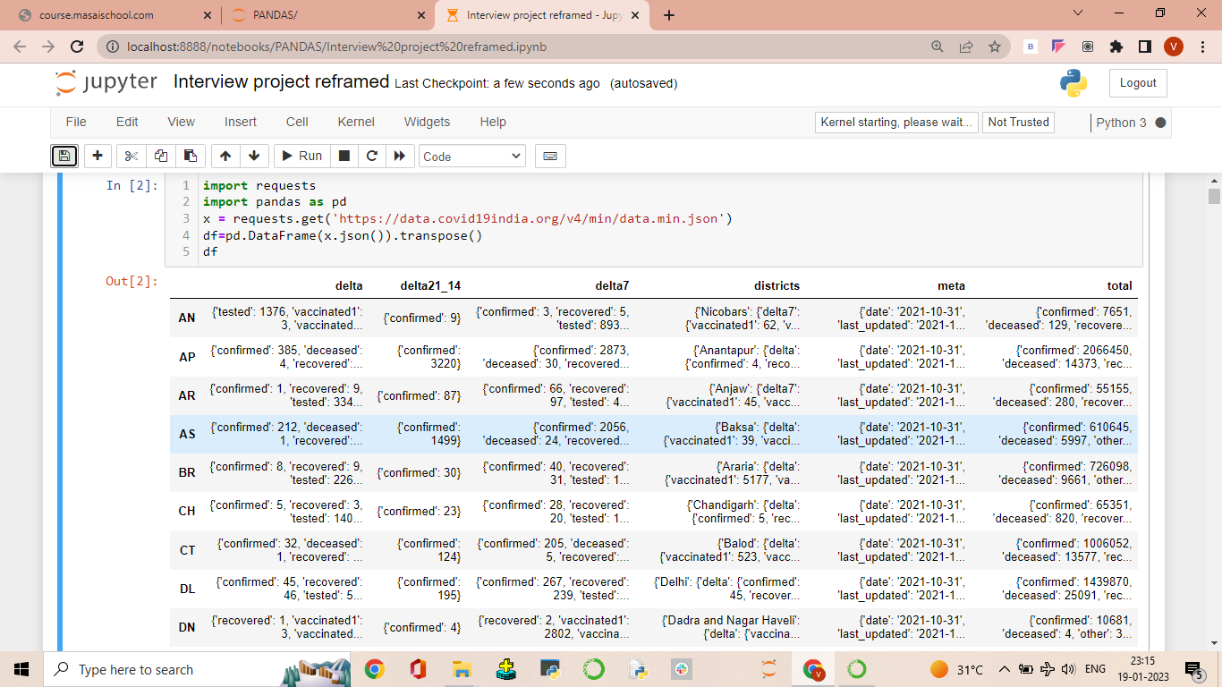

Slide 6
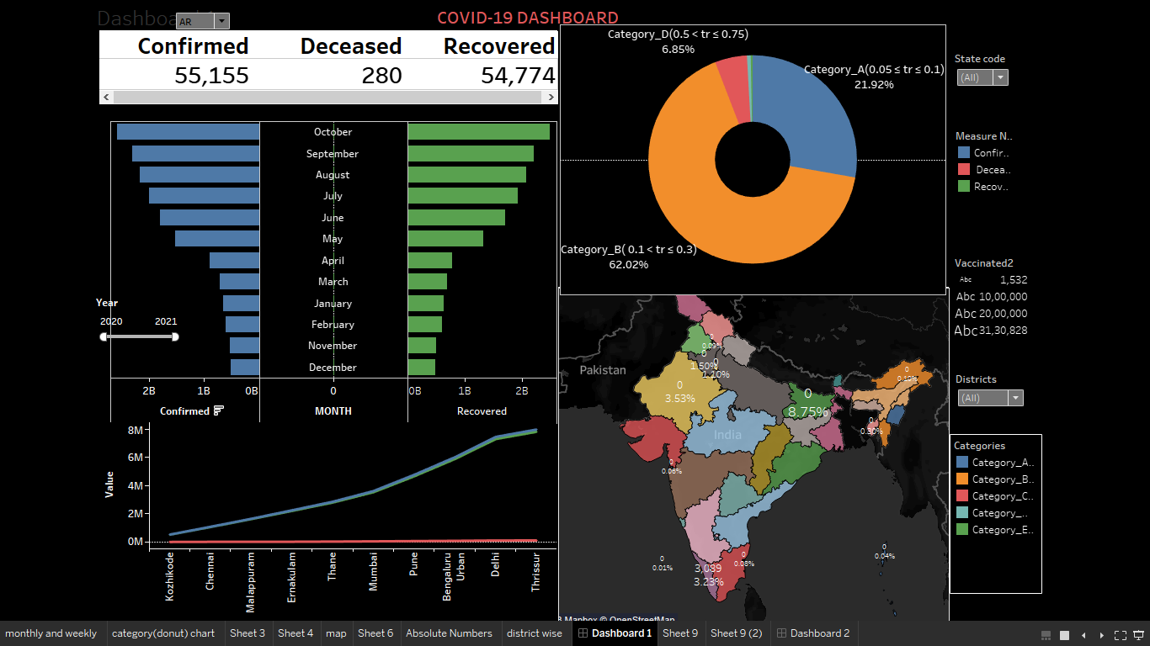

Slide 7
INSIGHTS
Highest number of covid-19 confirmed cases and highest number of deceased cases i.e 3089 found During October-2021 in Thrissur city, Kerala state
Maximum Vaccination rate(BOTH DOSES) found in Bihar state and there are no deaths.
Testing ratio(Tr) is inversely proportional to the number of deaths as the Testing ratio increases from Category A to E districts number of deceased cases gradually decreases.
As the testing ratio increases the number of recovered cases are also high

Slide 8
Problems Encountered
While scraping data we faced issue which we resolved by collaborative research and discussion
While creating the data frame we encountered an error due to null values which was resolved by using dropna()
We were facing some issue while extracting and cleaning the data from the nested dictionary which we resolved using list comprehension and SQL

Slide 9
CONCLUSION
The pandemic put a spotlight on why data is essential for navigating complexity, identifying risk, and seeing the progress towards recovery and a ‘new normal’..
These visualizations and stories inspire you to use data to look for answers, and gain new perspectives.

Slide 10
SCOPE FOR FUTURE WORK
Explore new data sources
Learn from each other
Crises require rapid response
Innovate…
.

Slide 11


